Slide 1

CS401 Modern Programming Practices (MPP) Professor Paul Corazza
MAHARISHI UNIVERSITY of MANAGEMENT
Engaging the Managing Intelligence of Nature
Computer Science Department

Slide 2
© 2015 Maharishi University of Management, Fairfield, Iowa
All rights reserved. No part of this slide presentation may be reproduced or utilized in any form or by any means, electronic or mechanical, including photocopying or recording, or by any information storage and retrieval system, without permission in writing from Maharishi University of Management.

Slide 3
Lecture 3: Inheritance and Composition
Reflecting the Whole in the Part

Slide 4
Wholeness of the Lesson
Inheritance and Composition are types of relationships between classes that support reuse of code. Inheritance makes polymorphism possible, but can lock classes into a structure that is may not be flexible enough in the face of change. Composition is more flexible but does not support polymorphism. Composition and inheritance are techniques based on the principle of preserving sameness in diversity, silence in dynamism

Slide 5
Inheritance
(more general, abstract)
Super class
Base Class
Relationship between a general and a specific class
‘is-a’ relationship
no multiplicity
public class Shape {
...
}
(more specific, concrete)
subclass
public class Rectangle extends Shape {
...
}
Rectangle inherits all attributes
and methods from Shape that are not private

Slide 6
Java Inheritance Review
super object reference
To uncover parent methods, e.g. super.toString()
super() constructor
To call parent constructor
Has to be first line in constructor
Super() will be inserted by the compiler into any constructor that doesn’t explicitly use this() or super()
final keyword on a class
prevents inheritance
protected
Allows access by subtypes and objects in the same package
Object The ‘cosmic’ super class
Provides methods such as equals(), and toString()

Slide 7
Overriding a method
The subclass can change inherited behavior of the super class by overriding methods
To override an inherited method, you must declare the method in the subclass in the exact same manner as the super-class method
Best practice to also add the @Override annotation
@Override
public String toString() {
return "Employee [salary=" + salary + ", getFirstname()="
+ getFirstname() + ", getLastname()=" + getLastname()
+ "]";
}

Slide 8
Code Reuse
We’ve written the code for move() in our car class, and we want to re-use this code for our bicycle class.
Why would the following diagram not be the best design decision?
Notes:
Even if this code would work initially (which is could be questioned), in the long run, because a bicycle is not a car, changes to the car class that are fine for a car would automatically be inherited by the bicycle as well!
Example: car class may be updated to have a choice between automatic and manual transmission.
This change would not make any sense for the Bicycle, but when would you find out???

Slide 9
Code Reuse
The following classes all have a name property
Why may inheritance not be the best design decision?
With design always think about the long term
Notes:
Again, even though this might work as a short term solution, in the long run, we may want to change Person to have a firstname and lastname, how would you deal with that? The problem is that although we’ve re-used this property, this property really doesn’t actually have to mean the same thing to these different concepts. Causing problems in the long run when the code gets updated for one, and no longer reflects how it is supposed to be for the others.

Slide 10
Main Point 1
Inheritance is used to model IS-A relationships.
Although Inheritance offers reuse (the subclass inherits all public and protected methods and attributes), reuse should never be your primary motivation.
The field of pure intelligence is inherited by everyone, and can easily be accessed through the practice of the TM technique.

Slide 11
Composition vs. Inheritance
Problems with Inheritance
When should I favor Composition over Inheritance?

Slide 12
Advantages of Inheritance
Software re-use
Behavior inherited from another class does not need to be rewritten.
Increased reliability as the code will have been tested previously.
Rapid prototyping, or incremental development
Information hiding

Slide 13
Problems with Inheritance
Object classes are not self-contained.
Need to understand the super-class.
Errors (and assumptions) in the super-class ripple down to the sub-classes.
Inheritance offers weak encapsulation – super-classes can become fragile (easy to break).
...Composition also offers code re-use.

Slide 14
Inheritance vs. Composition
It is easier to change the whole class of composition, than a super-class in inheritance.
It is easier to add new subclasses (inheritance) than it is to add new part classes (composition), because inheritance comes with polymorphism.
Delegation has a (small) performance cost compared to inheritance.
Whole
Part

Slide 15
Inheritance vs. Composition conclusion
Make sure inheritance models the ‘is-a’ relationship
Make sure that this ‘is-a’ relationship is constant throughout the lifetime of the application.
Don't use inheritance just to get code reuse.
If all you really want is to reuse code and there is no ‘is-a’ relationship in sight, use composition.

Slide 16
Main Point 2
Inheritance should only be used when you have a clear IS-A relationship. Otherwise, it is better to use composition because it has better support for change.
Even in clear IS-A relationships, inheritance may not be the best choice because of its inflexibility.
Software relationships that reflect the real world are more natural and easier to understand. Likewise, life in accord with natural law tends to go forward without obstacles; life in violation of natural law tends to be “bumpy”.

Slide 17
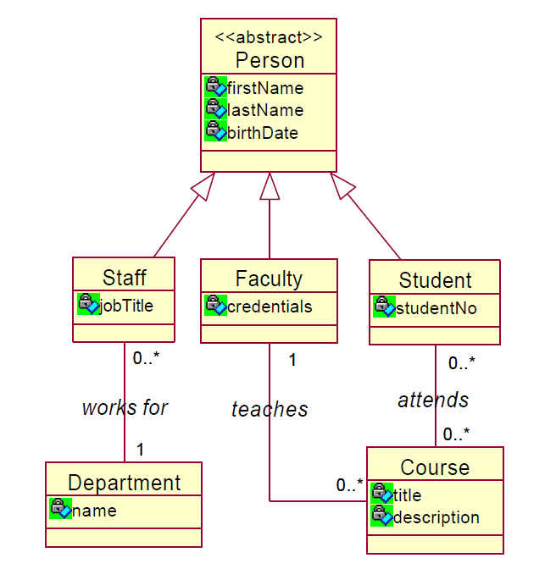
Example Composition over Inheritance
See any problems with this design?

Slide 18

Example Composition over Inheritance
Problems:
Inheritance is a static relationship and it must be decided at object construction time which type of person someone is
Once constructed a person cannot change from being a Student to being Staff or Faculty
In the real world people change all the time
Also a person cannot assume multiple roles of being a Staff member and a Student at the same time
Again, not how it really works

Slide 19
In-class exercise: Composition over Inheritance
In your small groups try to redesign this class hierarchy using composition.

Slide 20
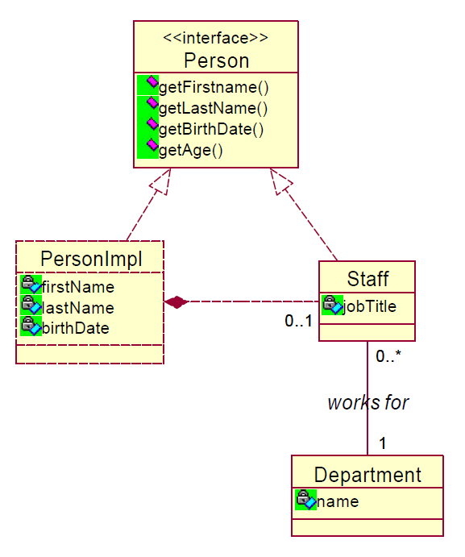
One Possibility
Rename the Person class to PersonImpl
Create a Person Interface that declares all public methods of PersonImpl
Create composition between PersonImpl and Staff
Implement the Person interface in PersonImpl and in Staff
In PersonImpl the Person methods will perform the actual business logic
In Staff the Person methods are delegation methods, i.e. they delegate the work to the corresponding methods in the PersonImpl object

Slide 21
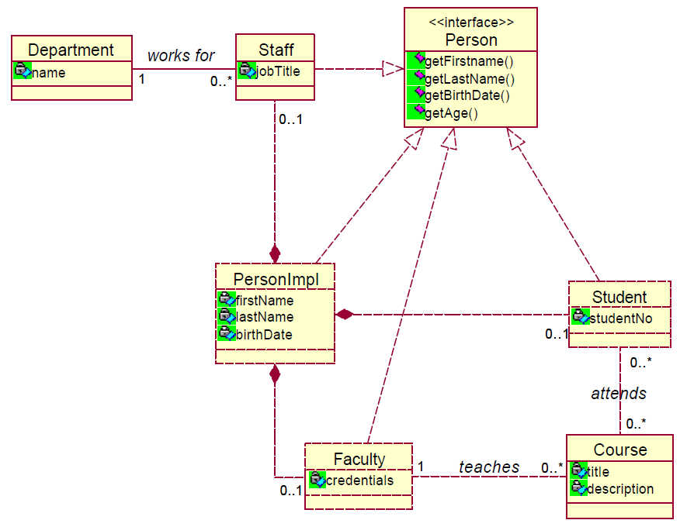
Problem
If we do the same for our other classes the diagram will become cluttered (composition relationship must be implemented for each subclass)

Slide 22
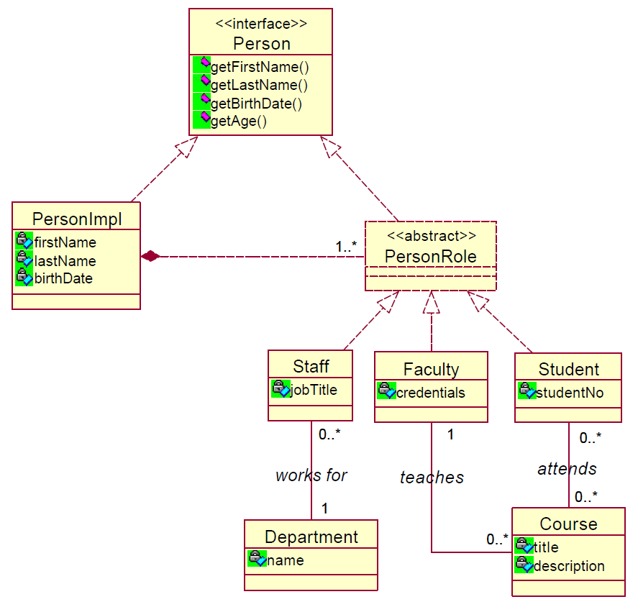
Solution
We can fix this with a PersonRole super class

Slide 23
Solution
Is there a reason for PersonRole to implement the Person interface??

Slide 24
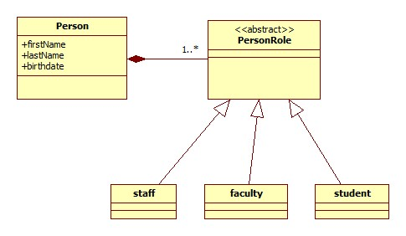
Solution
Why not make Person a concrete class and get rid of PersonImpl?
More on choosing
Interfaces/Abstract
Classes in
Lesson 6.

Slide 25
Mid-term Practice
Objectives:
Understand and discuss how to use Inheritance
Tasks
Draw a UML class diagram for the following problem statement

Slide 26
Mid-term Practice
Problem Description: Our rent-a-wreck business rents cars, trucks, motorcycles, and mopeds. Create a inheritance model that we might use for our rentals.
1)Show a few common attributes and methods for your super-class.
2)Show some unique attributes and at least one unique method for each sub-class.
3)Show one method that will be overridden in all sub-classes.

Slide 27
Summary
Today we considered the pros and cons of using inheritance. We saw that we must be cautious when using inheritance because it is a permanent relation for the lifetime of an object.
Our goal is to build software that supports change and extensibility.
In general we know that composition has better support for change so we favor using composition except in cases where we have a clear ‘is-a’ relationship.
We see the same in life, at the surface level there is constant change, Problems arise when change is needed but not easily supported.

Slide 28
Connecting the Parts of Knowledge With the Wholeness of Knowledge
When requirements change, you should implement these changes by adding new code, not by changing old code that already works.
Inheritance and Composition are Object-Oriented principles that support reuse of implementation.
Transcendental Consciousness is the infinitely adaptable field of pure intelligence that can be ‘reused’ by every individual at all places, at all times.
Wholeness moving within itself: In Unity Consciousness, the individual is united with everything else, and inherits the total potential of natural for fulfillment of all desires spontaneously.

